Slide 1
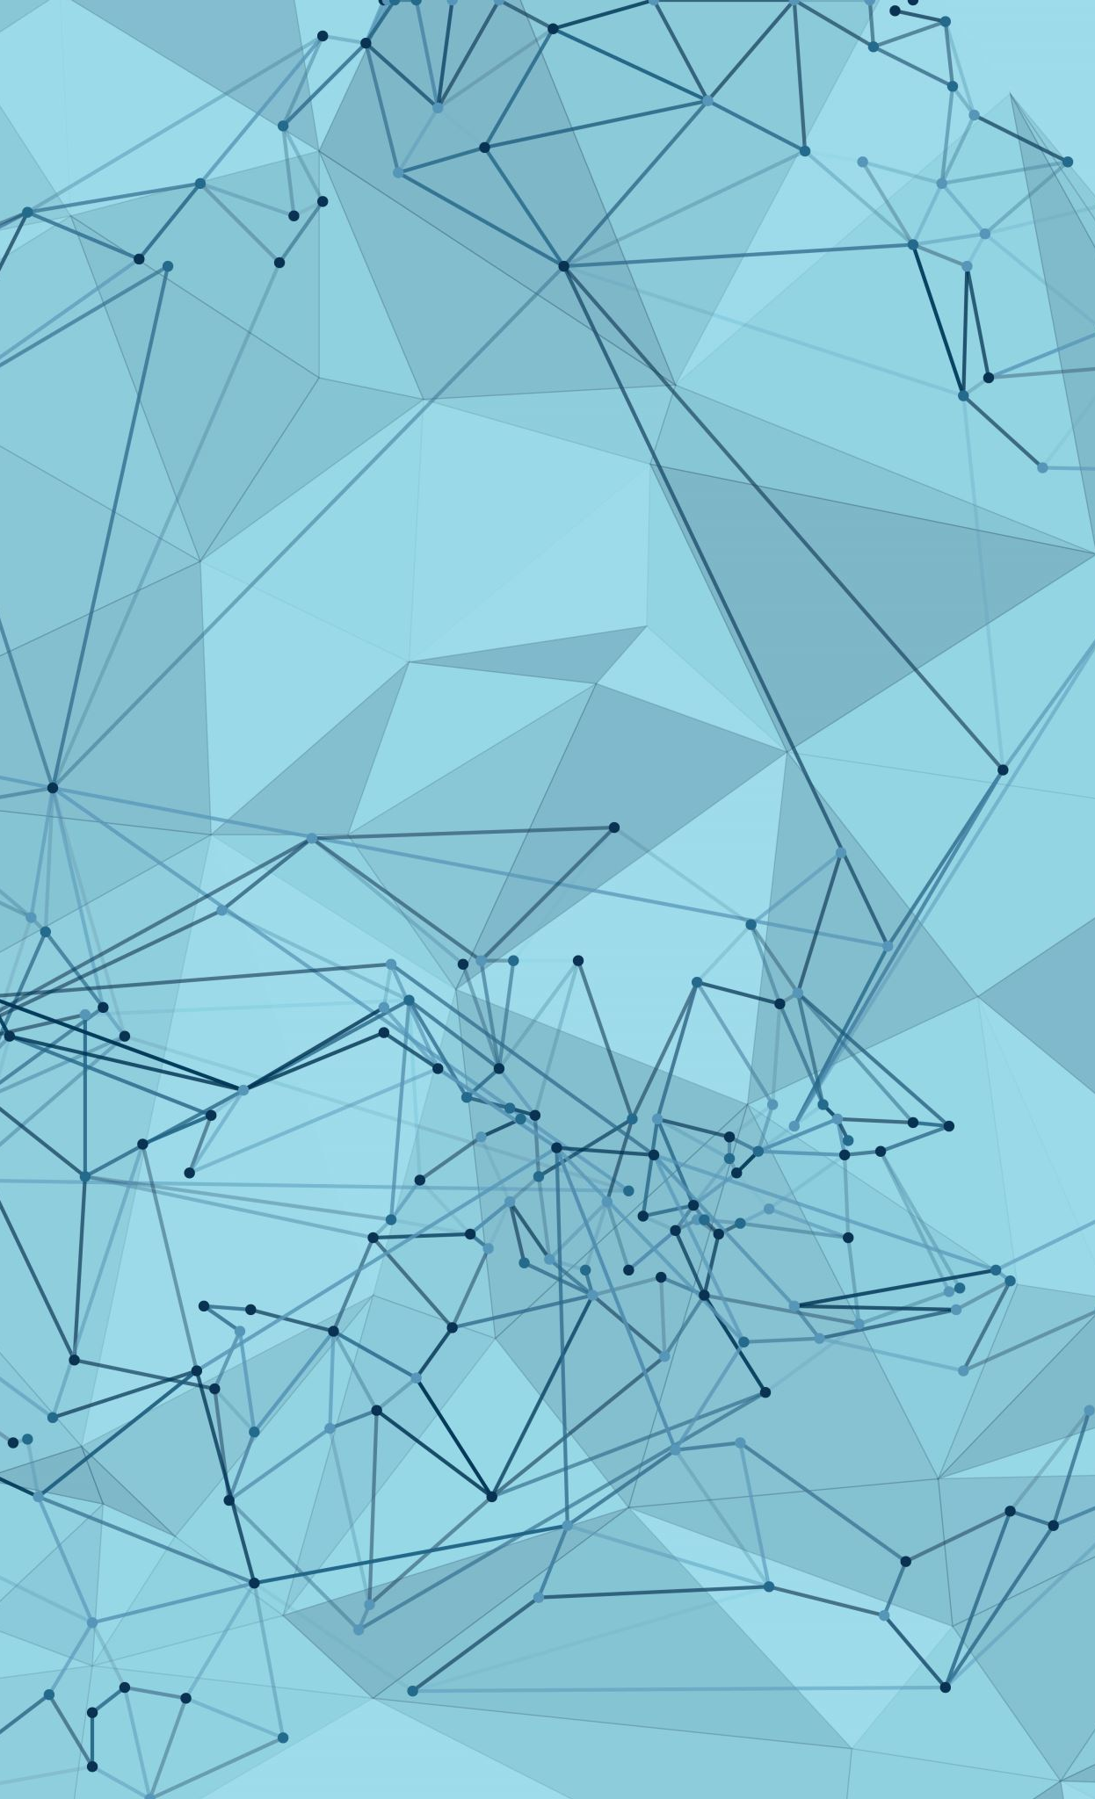
Scrum Agile and Waterfall
Overview
By: Elba Correa

Slide 2
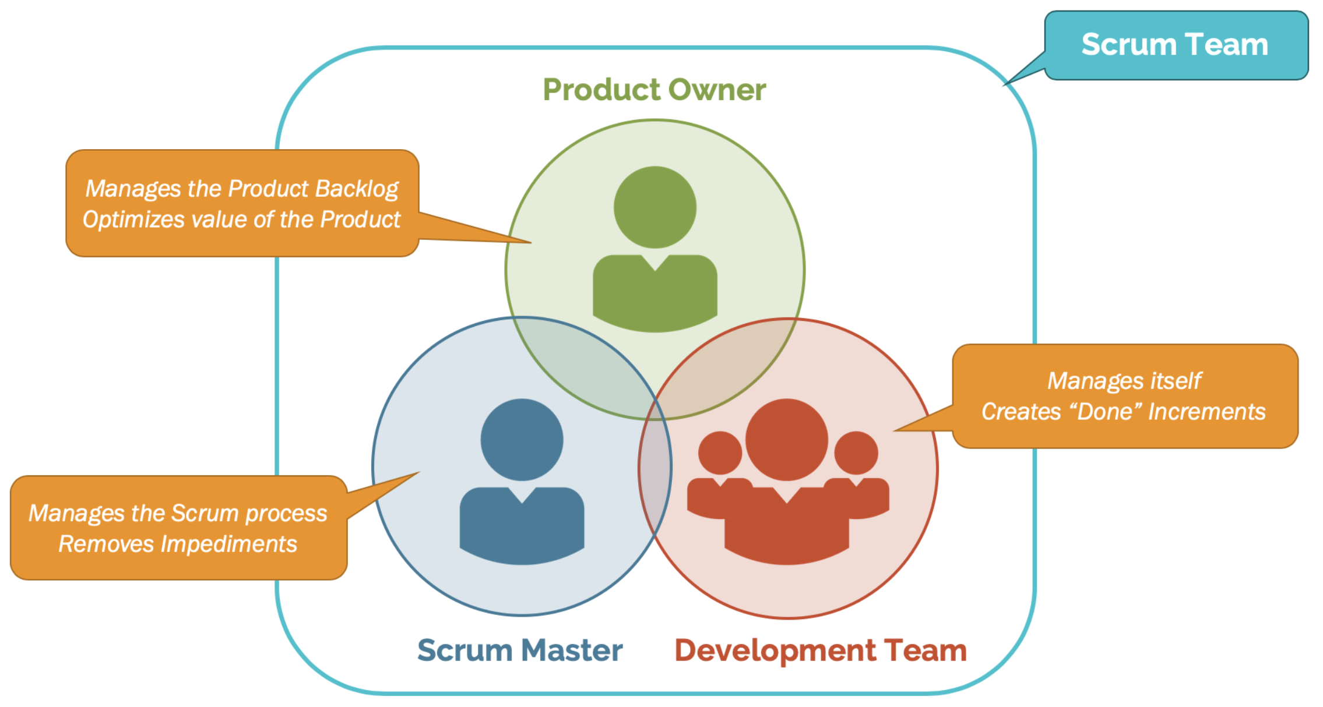
Agile Roles:
Product Owner:
Defines and prioritizes the product backlog
Voice of the customer
Maximizes product value
Scrum Master:
Leader for the team
Facilitates Scrum processes and events
Removes impediments to progress
Development Team:
Delivers working product increments
Self-organizing and cross-functional
Collaborates to plan and execute work
Notes:
In Agile, teamwork is structured around three key roles. The Product Owner prioritizes features and makes sure the team is building something valuable for the customer. The Scrum Master acts as a facilitator, helping the team follow the Agile process and overcome any obstacles. The Development Team is responsible for building and delivering the product incrementally, collaborating closely to meet project goals. Each role is crucial in ensuring the project's success and delivering value to the customer.

Slide 3
Agile SDLC Phases:
Envision | Planning | Sprints | Testing/QA | Release | Feedback/Retrospective | Maintenance/Operations
Define project scope and goals. Align stakeholder expectations. | Create and prioritize the product backlog. Define and estimate user stories. | Deliver working software increments. Daily stand-ups for alignment. Continuous code reviews and testing | Integrate testing throughout development. Automate tests for code quality. Conduct user acceptance testing. | Release working software to users. Gather feedback for future sprints. Consider continuous deployment. | Reflect on the sprint, identify improvements. Incorporate lessons learned into future work. | Monitor and support released software. Implement bug fixes and enhancements Track performance and user experience.
Notes:
In Agile, we build software in a continuous cycle, not a straight line. It starts with envisioning, where we figure out what to build and what the users need. Then, we plan by creating a list of things to do and figuring out what's most important. Next, we work in short bursts called sprints, where we build small parts of the software and check it regularly. During this time, we also test everything to make sure it works properly. Once it's ready, we release the working software to the users. But we don't stop there! We gather feedback from users and use it to improve the software in the next sprint. This keeps going, ensuring the software always gets better and meets the user's needs.

Slide 4
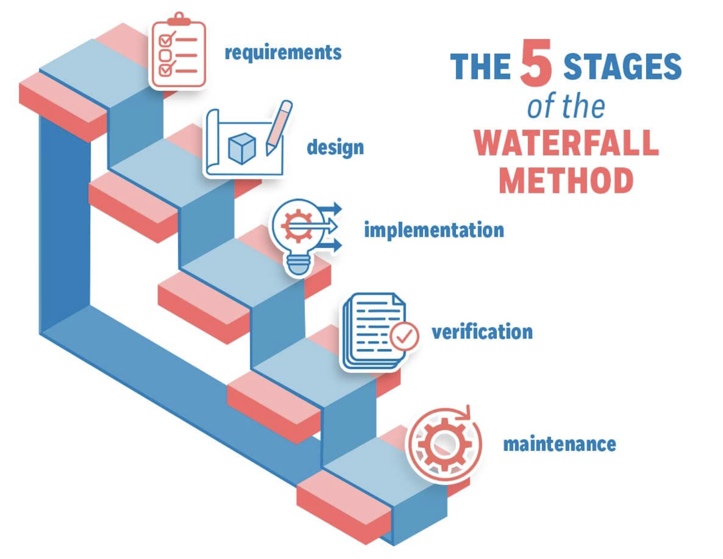
Waterfall Model:
Step-by-step process:
Requirements
Design
Implementation (Coding)
Testing
Deployment
Maintenance
Each step must be finished before moving to the next.
Good for projects with clear, unchanging needs.
Less flexible for changes during development.
Notes:
This method is more of a straight line. It begins with thorough requirements gathering, ensuring everyone is aligned on project goals and user needs. Next, a detailed design is created, outlining the software's structure and functionality. The implementation phase brings the design to life through coding. Rigorous testing follows, identifying and fixing any errors or defects. Once thoroughly tested, the software is deployed to its intended environment. Finally, the maintenance phase ensures the software continues to run smoothly, addressing any issues and making updates as needed. This linear model works best for projects with well-defined, unchanging requirements, but its lack of flexibility can be a challenge when adapting to unexpected changes or evolving user needs.
During the SNHU Travel project, we had a change in the type of destination to having them be centered around ‘rest and relaxation’ which would not have been possible if we used the waterfall approach.

Slide 5
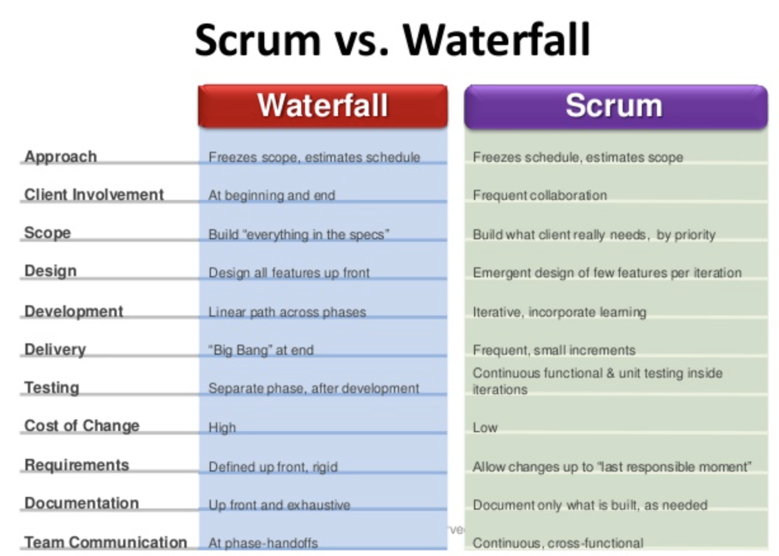
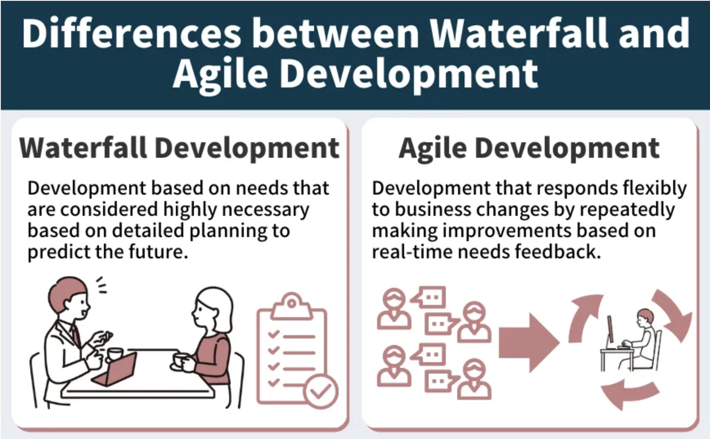
Waterfall or Scrum Agile?
Notes:
How will you know which method will work best for your project?
Waterfall is best used when you already have clear plans and when you have rules and terms you HAVE to follow. This method does not allow for changes once you get to the implementation phase.
Agile is best used when you require flexibility and continuously getting feedback to make updates. Factors to consider are requirements, flexibility, team collaboration, and others.
In the SNHU Travel project we used user input in the form of a focus group, we changed our vacation destination which would not have been possible with the waterfall method. The product owner also wanted this app to be released soon which means we would use the agile method to make use of our time and have something ready to deliver by that time. Overall, there are many factors to consider and I hope you got a better understanding of each method to make your decision wisely.

Slide 6
Resources
Doshi, H. (2017, January 23). How do the 3 scrum roles promote self-organization?. Scrum.org.
https://www.scrum.org/resources/blog/how-do-3-scrum-roles-promote-self-organization
Leanagiletraining. (2019, February 14). Scrum vs waterfall difference in Scrum course. Lean Agile Training - Certified Scrum Master
Course. https://leanagiletraining.wordpress.com/2019/02/14/scrum-vs-waterfall-difference-in-scrum-course/
Waseem | Edited by omer, A., & Abraham, M. (2023, March 2). Waterfall methodology – ultimate guide. Management.Org.
https://management.org/waterfall-methodology
Cobb, C. G. (2015). ​In The Project Manager’s Guide to Mastering Agile opens in new​ ​window.​ ​​essay, John Wiley & Sons Inc​.

